Slide 1
Consumer Credit Score
Bryson Davis
John Seifarth
Stat 184

Slide 2
Research Questions
Churn Bank Data (International Bank in EU, 10000 Customers via Kaggle and Maven Analytics)
Data contains attributes of account holders and their accounts.
Our goal is to determine what attributes affect credit score.
Our research questions:
Is credit score dependent on geographical location?
What about gender, number of products, and estimated salary?

Slide 3
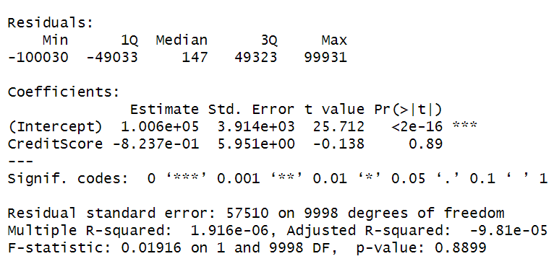
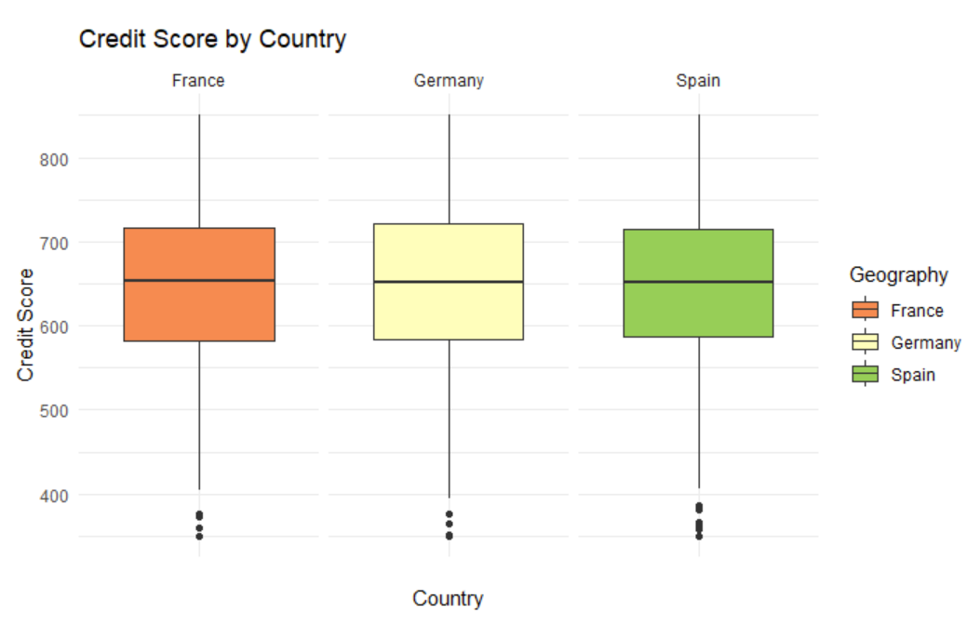
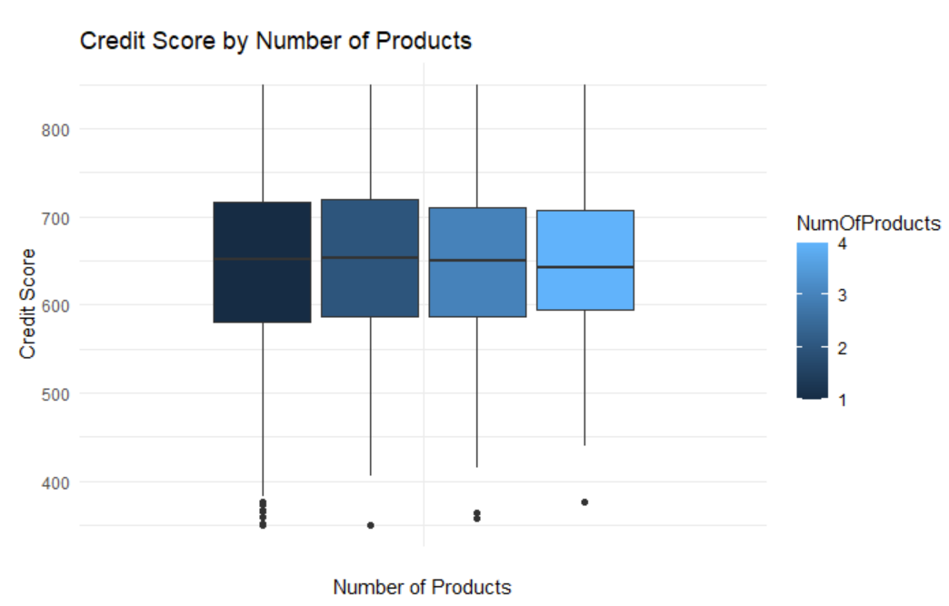
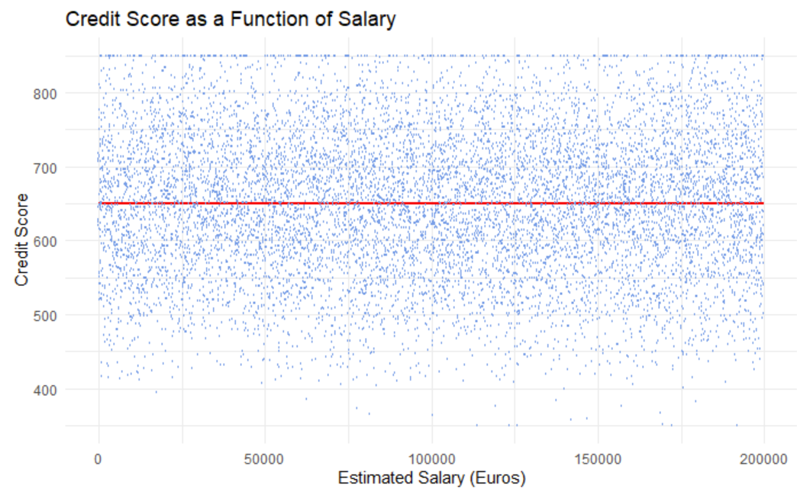
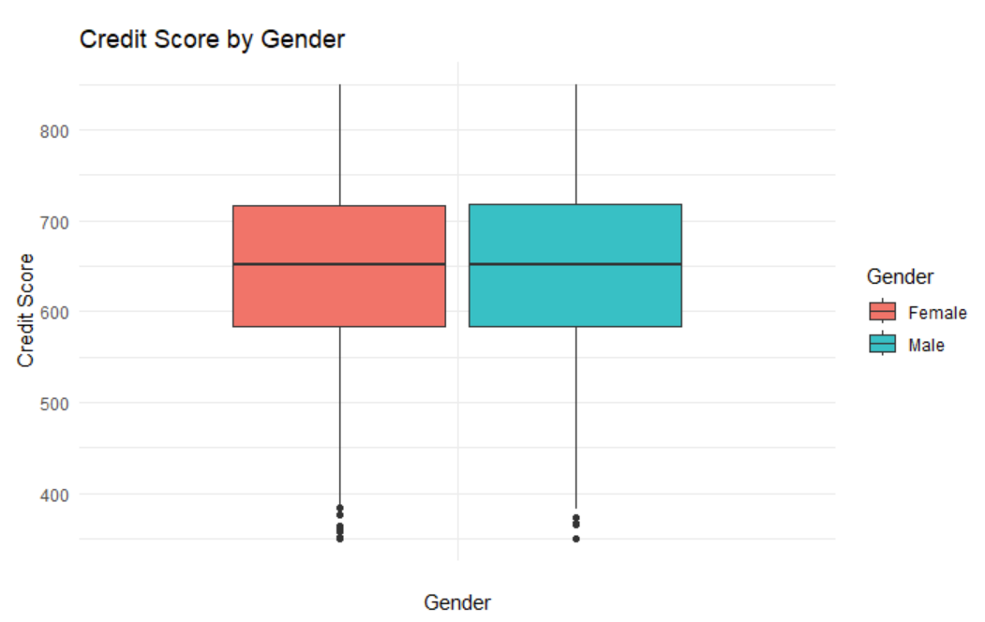
Exploratory Data Analysis

Slide 4
Challenges During EDA
Multiple releases/iterations of the data online.
Do we choose one or try to combine them? Which source is best?
Cleaning data and deciding what is important.
Choosing and coding graphs for exploratory data analysis.
Verifying the data meets the FAIR and CARE Principles.

Slide 5
Works Cited
Free Data Sets & dataset samples: Maven Analytics. Free Data Sets & Dataset Samples | Maven Analytics. (n.d.). https://mavenanalytics.io/data-playground
Kollipara, R. (2023, April 28). Bank customer churn. Kaggle. https://www.kaggle.com/datasets/radheshyamkollipara/bank-customer-churn

